Slide 1
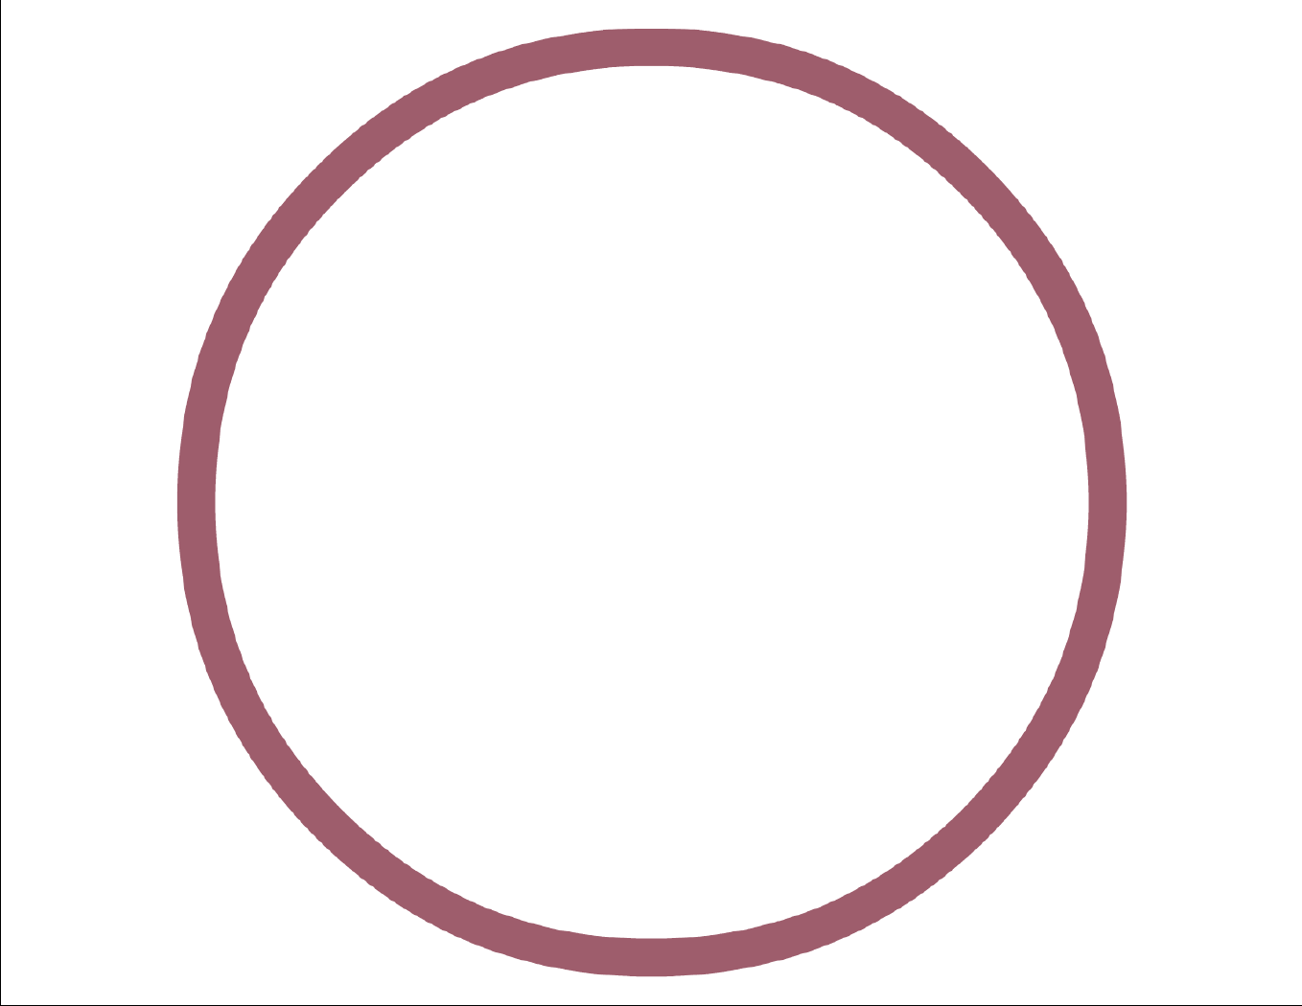




DOS Mario
POLAND KRAKÓW
Wojciech Grędel
Hubert Górowski
FPGA project

Slide 2
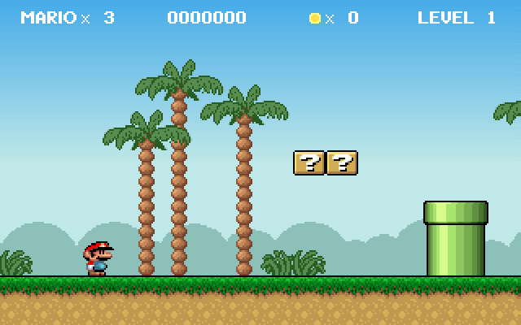
DOS Mario, released in ‘95

Slide 3
Project description
Resolution 640x480
24 bit color depth!(using external board)
Music output
Only one stage by far
Matlab scripts for generating .coe files for images and stages

Slide 4
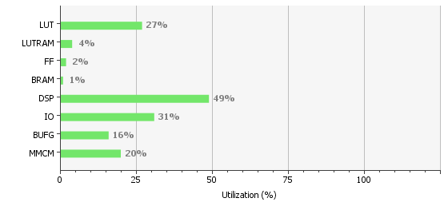
Project in numbers
Over 4000 lines of code + ROM, RAM and CLOCK IP’s

Slide 5
VGA extension board using ADV7125KSTZ50

Slide 6
Live demonstration

